Slide 1


Design Presentation on Comprehensive Digital Learning System for Students
Guided By: Presented By:
Prof. Mahendra Verma Atharv Sharma (0827IT233D02)
Abhishek Rathore (0827IT233D01)
Jatin Rao (0827IT233D03)
Ineesh Dubey (0827IT221064)
Harsh Suryavanshi(0827IT221056)

Slide 2
Contents
Technical Architecture
Sequence Diagram
Class Diagram
DFD
User Interface Design
Data Design
6.1 Schema Definition
6.2 E-R Diagram

Slide 3
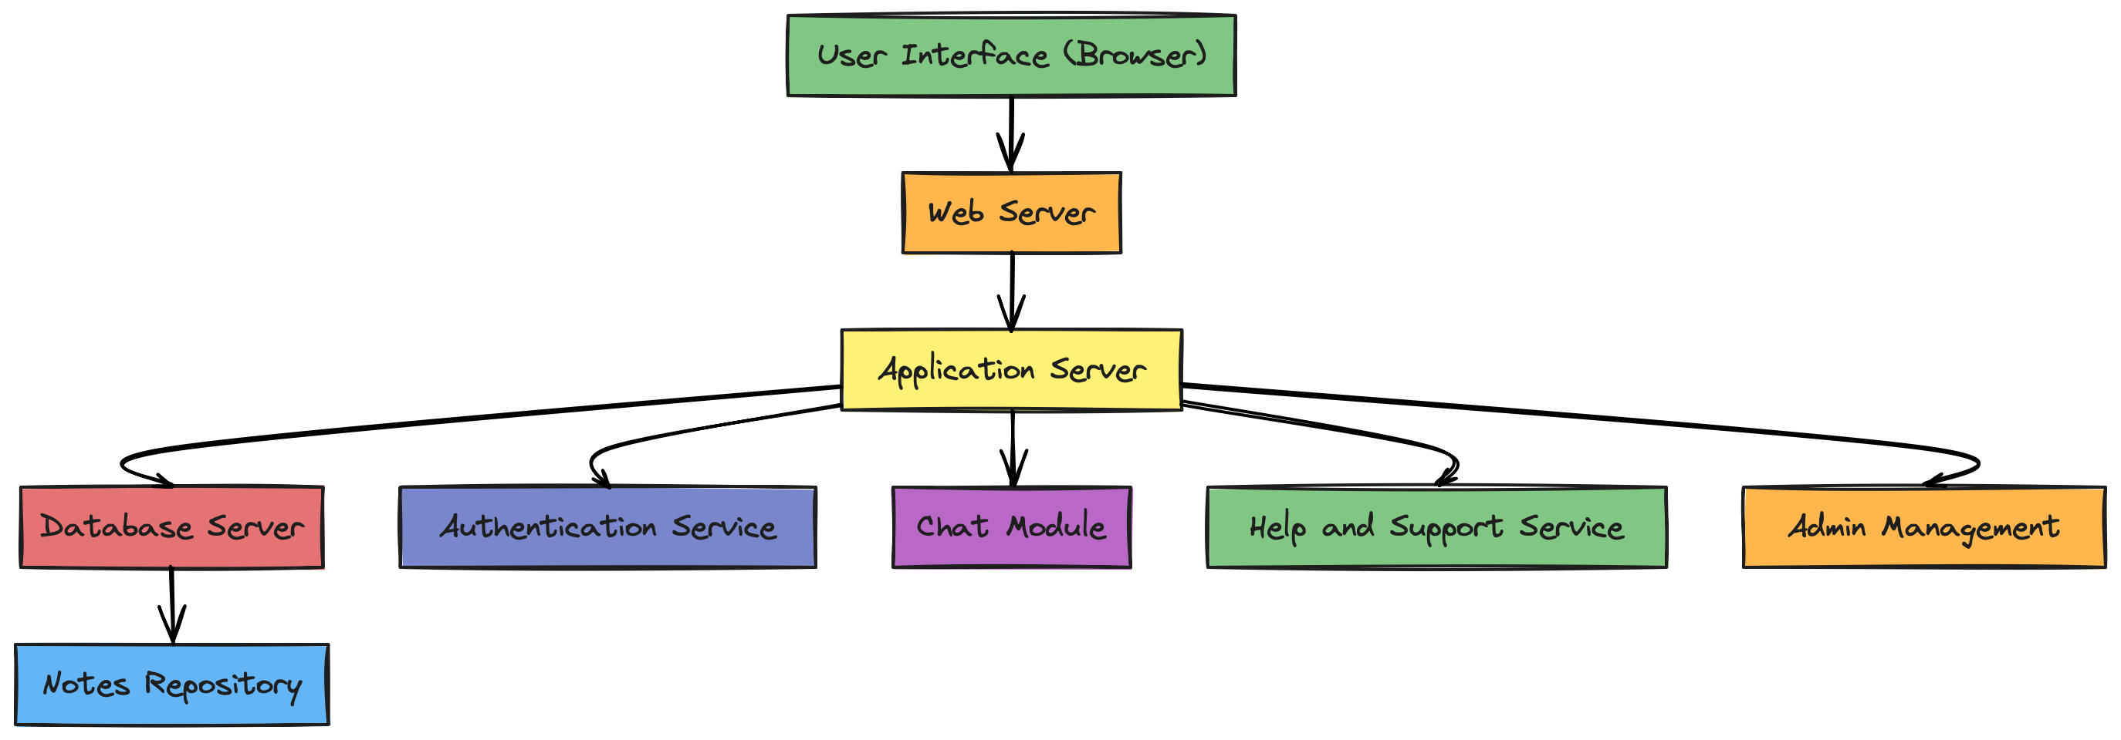
1. Technical Architecture

Slide 4
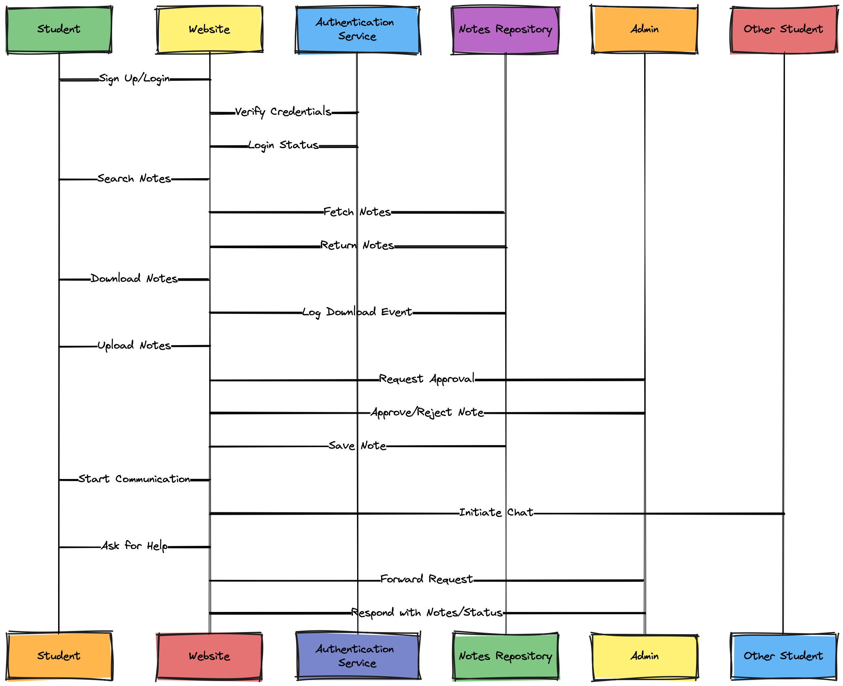
2. Sequence Diagram

Slide 5
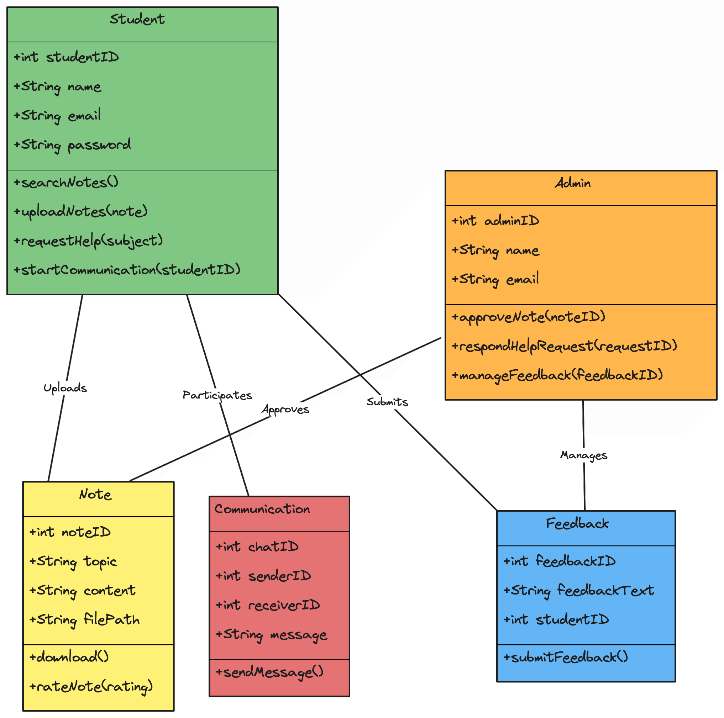
3. Class Diagram

Slide 6
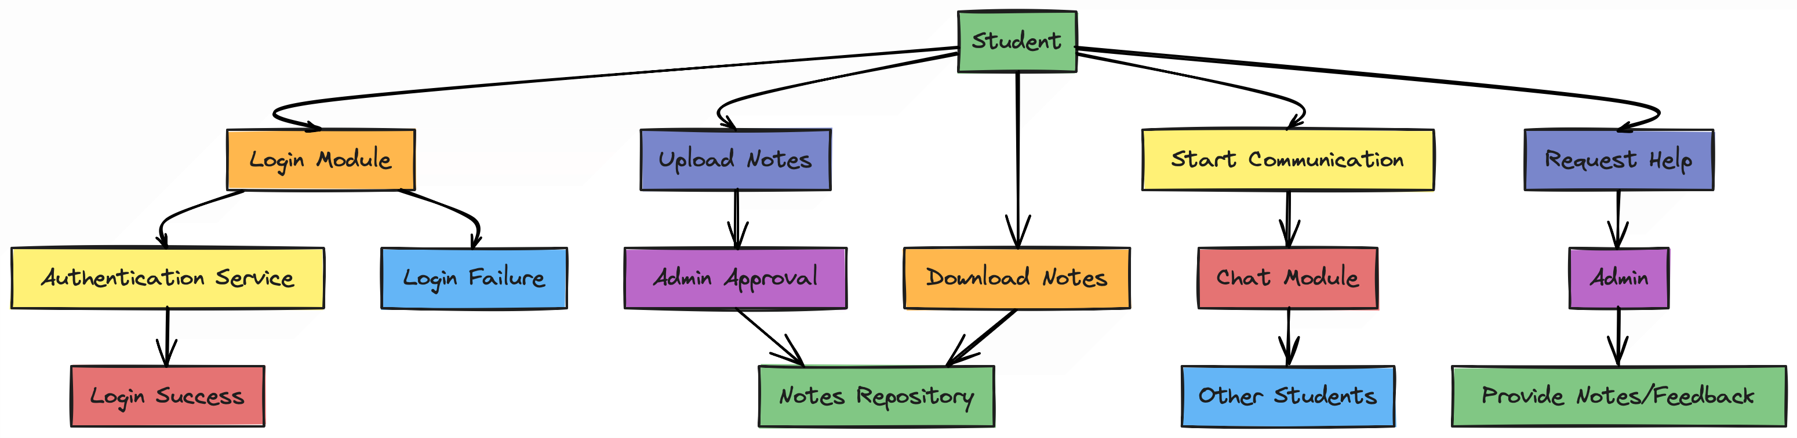
4. Data Flow Diagram

Slide 7
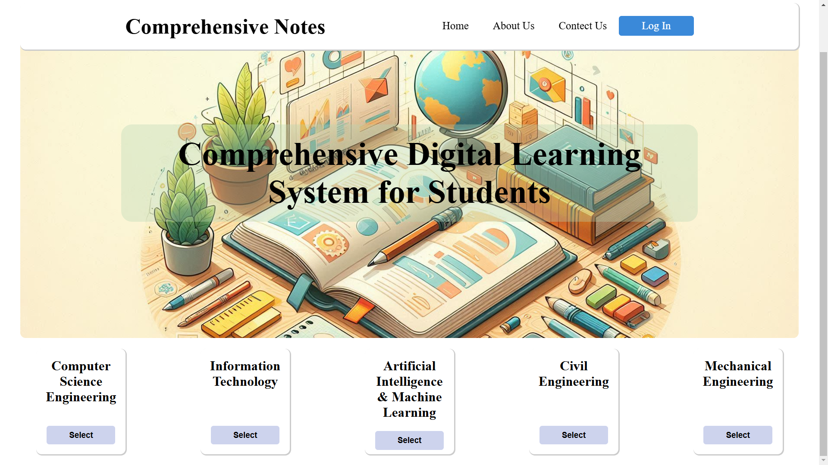
5. User Interface Design

Slide 8
6. Data Design
The Data Design section focuses on how data is organized, stored, and accessed in your system. It ensures that your project is optimized for performance, scalability, and maintainability. It includes:
6.1 Schema Definition:
The schema definition outlines the structure of your database. It describes tables, fields, data types, and relationships within the database..
6.2 E-R Diagram:
A visual representation of the entities, their attributes, and the relationships between them in your system

Slide 9
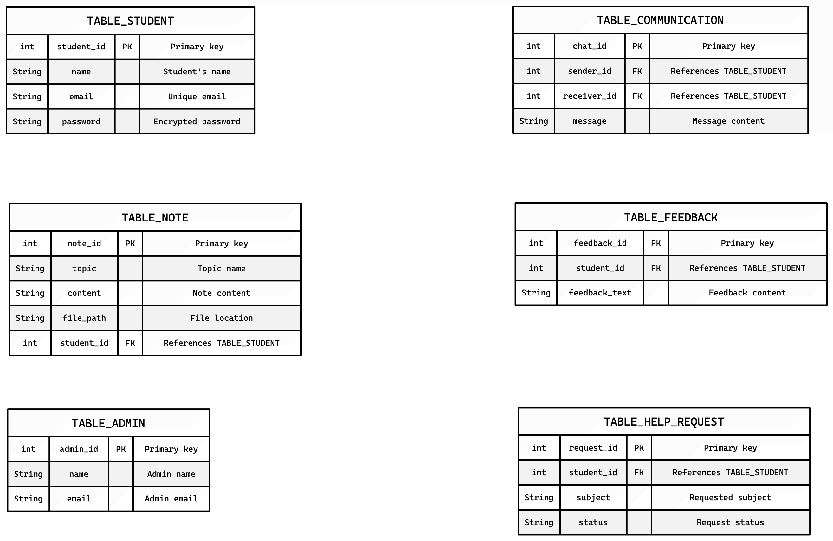
6.1 Schema Definition

Slide 10
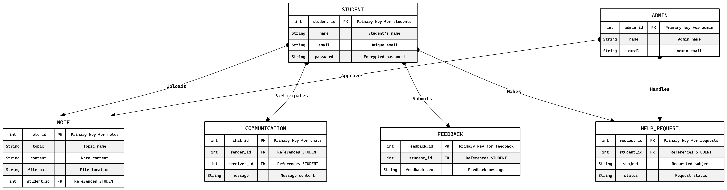
6.2 E-R Diagram

